Slide 1
Portfolio Website Presentation
Brodey Bright

Slide 2
Purpose
The portfolio website has been meticulously crafted to exhibit a diverse range of skills pertinent to web development and IT professionalism. These include:
Crafting HTML that is not only readable but, crucially, syntactically and semantically valid.
Leveraging fundamental CSS layout principles such as flexbox and/or grid to fashion responsive site elements.
These skills exemplify the proficiency in web development, poised to impress potential clients or employers with a fully functional and responsive website.

Slide 3
Target Audience
The primary target audience for the portfolio website comprises potential clients from small businesses aiming to develop or enhance their websites or web applications. Additionally, the site caters significantly to prospective employers seeking junior web developers to join their teams or companies.

Slide 4
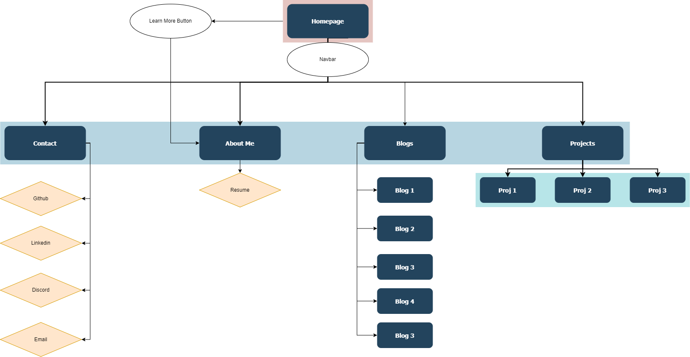
Sitemap

Slide 5
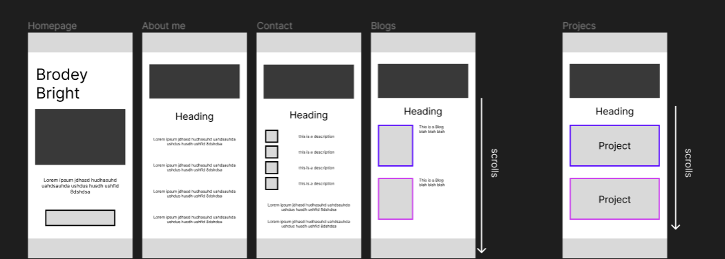
Mobile Wireframes
The mobile wireframes, having been created earlier in the project, are intentionally less detailed compared to the desktop wireframes. Despite this difference, both versions maintain a consistent structure, featuring key components such as headers, footers, images, buttons, and text. This uniformity ensures a cohesive user experience across different devices, with the main distinction being the optimization of layout and functionality for mobile screens.

Slide 6
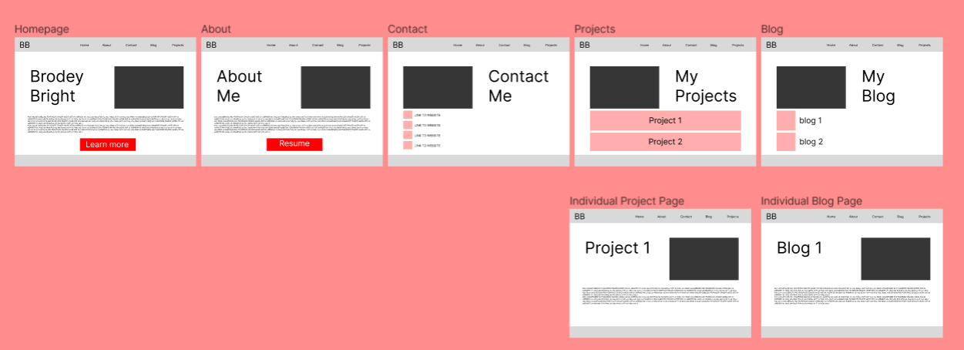
Desktop Wireframes

Slide 7
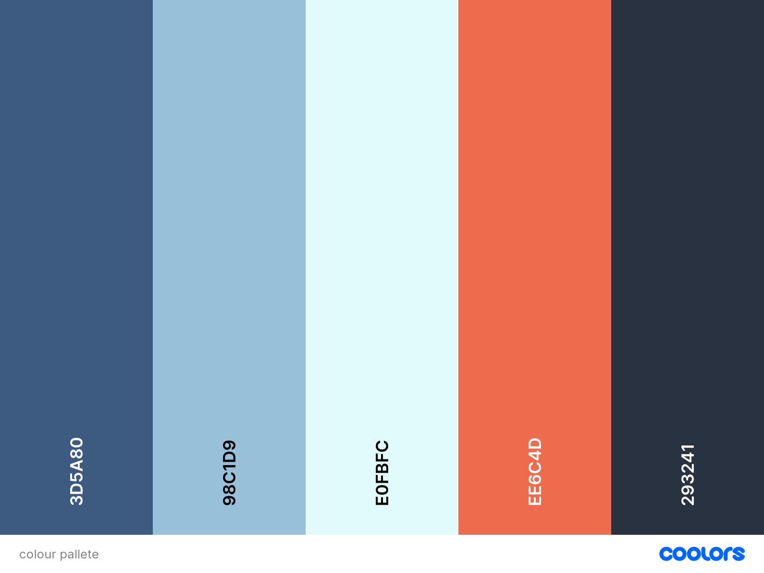
Color Palette
The website places significant emphasis on color usage, ensuring a harmonious contrast between various hues. The combination of light and dark blues, complemented by a vibrant contrasting red, forms a visually appealing color palette for visitors. Importantly, this palette is designed with full accessibility in mind, ensuring an inclusive experience for all users.

Slide 8
Functionality and Features
The website's functionality and features are meticulously integrated to ensure a seamless user experience, blending both design and technical elements harmoniously.

Slide 9
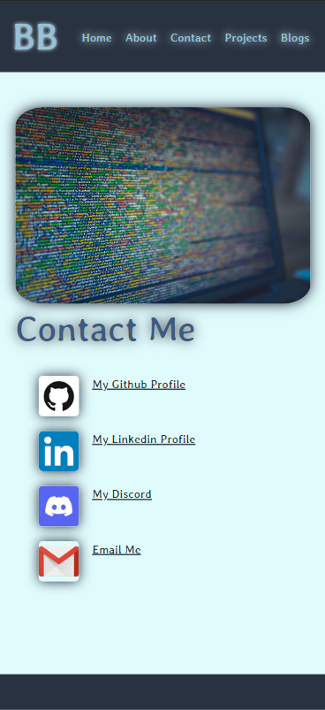
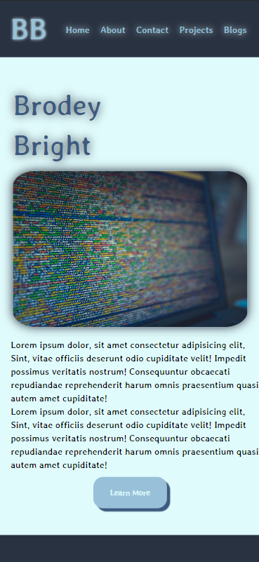
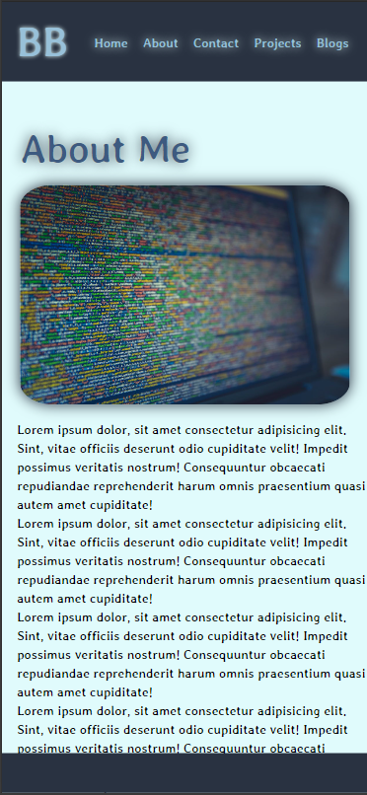
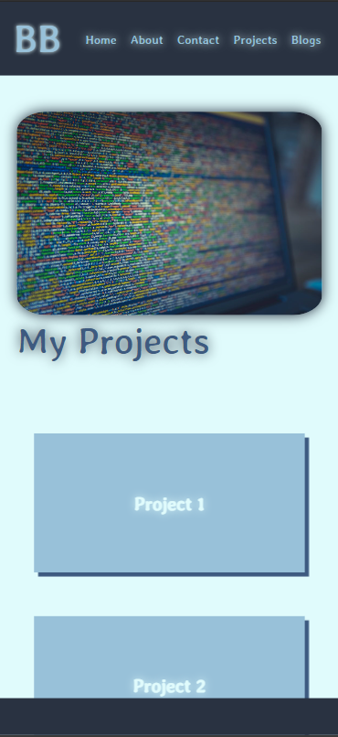
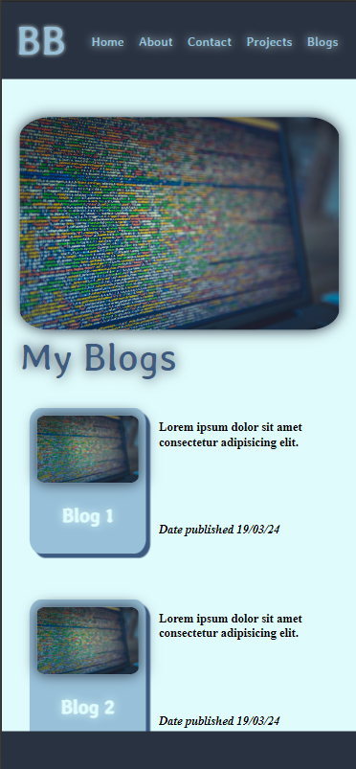
Layout
The website boasts a straightforward layout, with a key emphasis on the placement of text. Anchoring text to the left-hand side of the screen aligns with the natural reading pattern of most individuals, facilitating a seamless and effortless reading experience throughout the website.

Slide 10
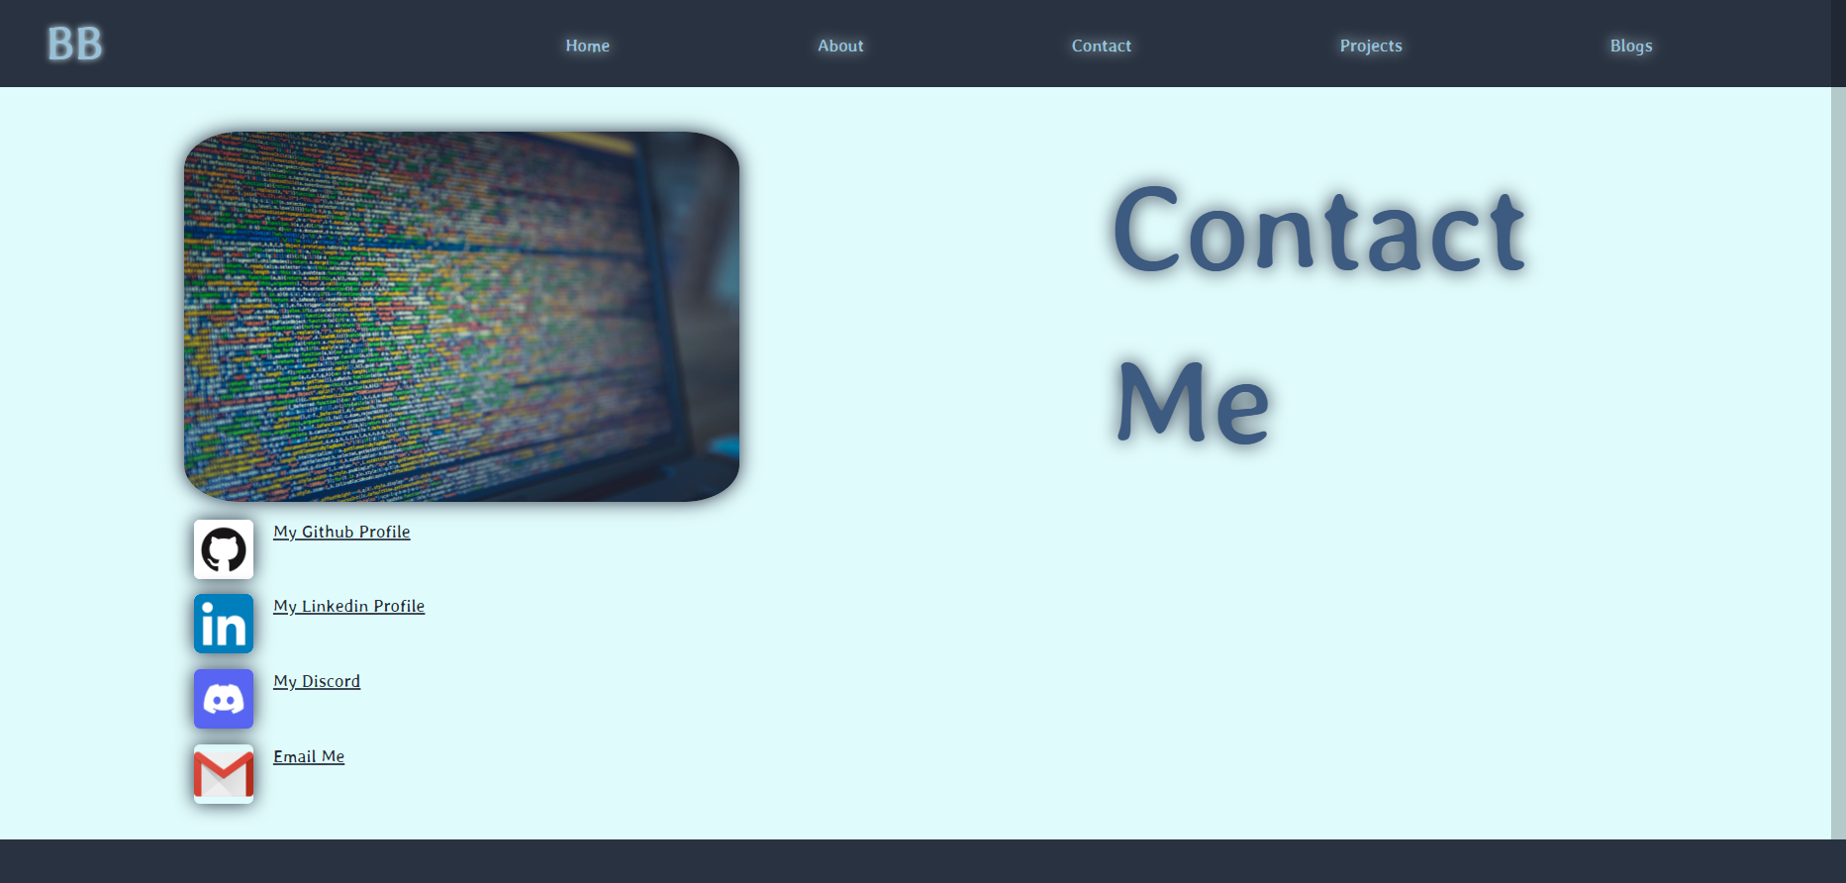
Navigation
Both the mobile and desktop versions feature identical navigation systems, comprising a simple navigation bar positioned at the top of the page. This consistent layout ensures seamless accessibility across different devices, enabling users to easily navigate between various pages.

Slide 11
Images
Each page of the website prominently features a large image at the top, strategically designed to capture the user's attention upon arrival. This captivating visual element serves as a focal point, drawing visitors into the content and setting the tone for their browsing experience.

Slide 12
Animations
The website incorporates simple animations strategically throughout, enhancing both functionality and design. These animations serve to improve user experience by providing visual cues, guiding navigation, and adding an engaging touch to the overall design aesthetic.

Slide 13
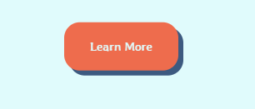
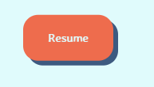
Buttons
Buttons throughout the website are dynamically animated, elevating upon interaction and transitioning to a contrasting red hue. This animation not only enhances the visual appeal but also increases interactive functionality, effectively engaging visitors and encouraging further exploration of the site's offerings.

Slide 14
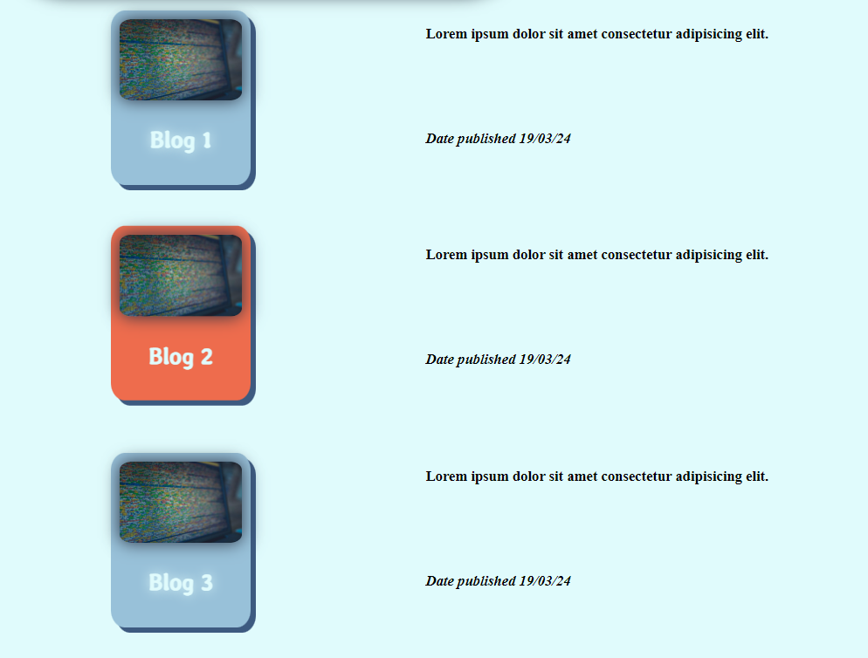
Cards
The website employs animated cards to showcase projects and blog posts, enhancing user engagement when interacting with each element. Upon hovering over a card, it animates to provide feedback and captivate the user's attention. Additionally, each card transitions to a contrasting red tone upon interaction, further stimulating user engagement and highlighting the selected item.

